Slide 1
Memory Management
Week 11

Slide 2
Memory
Memory comes in tiers
  Main memory (RAM): fast, but expensive and smaller
  Secondary storage (SSDs and hard drives): cheap and large, but much slower
The OS has to manage RAM carefully, because there's never quite enough
RAM is volatile: it is cleared when the power goes off

Slide 3
Memory Hierarchy
From fastest and smallest to slowest and largest:
  Registers: inside the processor. What's in your hands
  Cache (L1, L2, L3): on the processor chip. Your desk
  RAM: the bookshelf in your room
  SSD or hard drive: the library across campus (Storage, I/O, and Backups week)
Keep what you use most close at hand. Recently used data is likely to be used again soon (temporal locality)
Apple silicon and many phones use unified memory: the processor and graphics share the same RAM

Slide 4
Memory Management Strategies
Fetch: when to bring data into RAM, only when asked for (demand) or ahead of time (anticipatory)
Placement: where in RAM to put it
Replacement: what to remove from RAM to make room
The same three questions come back for pages, later this week

Slide 5
Logical vs Physical Memory
Logical (virtual) memory: how a program sees memory, as one neat, continuous space
Physical memory: where the data really is in the RAM chips
The OS and hardware translate one into the other on every memory access
Like a building directory: you look up "Room 5", and it tells you which floor and door that really is

Slide 6
Contiguous vs. Noncontiguous Allocation
Contiguous: the whole program sits in one unbroken block
  Simple, but a big enough block may not exist
Noncontiguous: the program is split into pieces placed wherever they fit
  More overhead, but many more programs fit in memory at once
The same trade-off as file allocation in the File Systems week

Slide 7
Fixed Partitions
Memory is split into fixed-size blocks, and each process gets one
Internal fragmentation: a small process doesn't fill its block, so the rest is wasted
Base and limit registers stop a process from touching memory outside its block
Historical note: early systems loaded each program at a fixed address, so it could only run in one partition. Still worth knowing because it shows the problem virtual memory was invented to solve

Slide 8
Variable Partitions
Each process gets exactly as much memory as it needs, so no internal fragmentation
But as processes come and go, they leave holes
  External fragmentation: enough free memory in total, but split into holes too small to use
Fixes:
  Coalescing: join neighboring free holes into one
  Compaction: move everything together to make one big free block. Works, but slow

Slide 9
Memory Placement Strategies
Where should a new process go?
  First fit: the first hole big enough. Fast and simple
  Best fit: the hole that leaves the least space over. Slower
  Worst fit: the biggest hole, so the leftover space is still useful
Like parking: take the first open spot, the tightest spot, or the roomiest spot

Slide 10
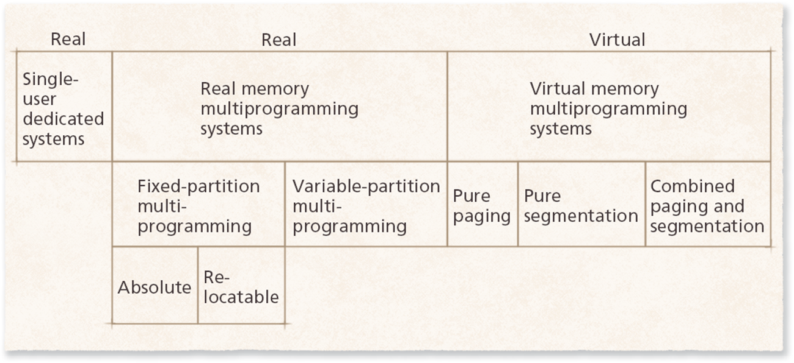
Evolution of Memory Organizations
From single-user systems, to fixed and variable partitions, to virtual memory with paging and segmentation

Slide 11
Virtual Memory
A process can run without all of it being in RAM at once
Each process gets its own private, continuous address space, and the OS decides where each piece really lives
  Like every tenant thinking they have the whole building, while the landlord assigns the real rooms
Benefits:
  Programs can be bigger than RAM
  More programs can run at once
  Programs can't see or change each other's memory

Slide 12
How Virtual Memory Works
Programs use virtual addresses. RAM uses physical addresses
The MMU (memory management unit), part of the processor, translates between them
The TLB (translation lookaside buffer) is a small cache of recent translations, so most lookups are instant
Memory is split into blocks called pages or segments, and only the ones being used need to be in RAM
Notes:
Linux kernel documentation: Memory management concepts: https://docs.kernel.org/admin-guide/mm/concepts.html

Slide 13
Paging
A page is a fixed-size block of a program's virtual memory, often 4 KB
A frame is a block of RAM the same size
Any page can go in any free frame, so there is no external fragmentation
Only the last page of a process may be partly empty (a little internal fragmentation)
A page table records which frame holds each page
Notes:
Linux kernel documentation: Page tables: https://docs.kernel.org/mm/page_tables.html

Slide 14
Segmentation
A segment is a piece of a program that makes sense as a unit, such as its code, its data, or its stack
Segments are different sizes, and usually bigger than pages
Each segment needs one continuous block of RAM, so external fragmentation comes back
Modern systems mostly use paging, sometimes combined with segments

Slide 15
Page Faults
A page fault happens when a program uses a page that isn't in RAM right now
The OS pauses the program, loads the page from the drive, and then lets it continue
The drive is far slower than RAM, so lots of page faults make everything slow
That's why an app you haven't used in a while can take a moment to come back
Minor page faults, where the page is already in RAM but not yet mapped, are common and quick

Slide 16
When to Load Pages
Demand paging: load a page only when the program asks for it
  Simple, and only loads what is needed, but the program builds up its pages one fault at a time
Anticipatory paging (prefetching): guess which pages will be needed and load them early
  Faster when the guesses are right, wasteful when they are wrong
Modern systems mostly use demand paging, with some smart prefetching, such as reading ahead in a file

Slide 17
Page Replacement
When RAM is full and a page fault happens, one page has to go
If that page was changed, it must be written back to the drive first
The goal: pick a page that will not be needed again soon, so there are fewer page faults
Each strategy is a different guess about the future, with a different amount of overhead

Slide 18
First-In-First-Out (FIFO) Page Replacement
Throw out the page that has been in RAM the longest
Low overhead, but it may throw out a page that is still used all the time
Belady's anomaly: with FIFO, giving a process more frames can sometimes cause more page faults, not fewer

Slide 19
Least-Recently-Used (LRU) Page Replacement
Throw out the page that has gone the longest without being used
Uses temporal locality: recently used pages are likely to be used again
Usually better than FIFO, but tracking every use adds overhead
Can do badly when a program loops over more pages than will fit

Slide 20
Clock and Not-Used-Recently
Cheaper ways to get close to LRU
Second chance: check the oldest page. If it was used recently, clear its "used" bit and give it another turn
Clock: the same idea, with the pages arranged in a circle and a pointer moving around like a clock hand
Not used recently (NUR): use each page's "used" and "changed" bits to pick one quickly

Slide 21
Random and Least-Frequently-Used
Random: pick any page. Very low overhead, but it may throw out the page needed next
Least frequently used (LFU): throw out the page used the fewest times
  But a page used heavily long ago can hang around, while newer pages get thrown out

Slide 22
Page Replacement, Worked Out
Pages requested in this order, with 3 frames of RAM. F marks a page fault
Request | 7 | 0 | 1 | 2 | 0 | 3 | 0 | 4 | 2 | 3 | 0 | 3 | 2 | Faults
FIFO | F | F | F | F |  | F | F | F | F | F | F |  |  | 10
LRU | F | F | F | F |  | F |  | F | F | F | F |  |  | 9
Optimal | F | F | F | F |  | F |  | F |  |  | F |  |  | 7
Optimal throws out the page that will not be needed for the longest time. It needs to know the future, so it is only used to measure the others
LRU comes closest to Optimal, which is why real systems try to approximate it
Notes:
Page reference string 7,0,1,2,0,3,0,4,2,3,0,3,2 with 3 frames. FIFO: 10 page faults. LRU: 9 page faults. Optimal: 7 page faults.

Slide 23
Page Size
Small pages: less wasted space inside pages, and less memory needed for what a process is using
Large pages: fewer page table entries, each TLB entry covers more memory, and fewer drive reads
Many systems support both. Linux's huge pages can be 2 MB instead of 4 KB, which helps big databases and virtual machines
Notes:
Linux kernel documentation: Transparent Hugepage Support: https://docs.kernel.org/admin-guide/mm/transhuge.html

Slide 24
Global vs. Local Page Replacement
Global: choose a page to replace from any process in the system
  Global LRU (gLRU): replace the least recently used page in the whole system
  SEQ: use LRU, but switch to most recently used when a process reads through pages in order, like streaming a big file
  Simple, but one process can take memory from the others
Local: each process only replaces its own pages
  Lets the OS give more memory to more important processes

Slide 25
Other Ideas You May See
Static vs dynamic frame allocation: a process gets a fixed number of frames, or a number that changes as it runs
Far page replacement: a near-perfect strategy on paper, but too complex to have been used in real systems
Voluntary page release: a program tells the OS it no longer needs a page, so the memory can be reused sooner

Slide 26
Thrashing
A process is thrashing when it spends more time swapping pages in and out than doing work
Like opening so many browser tabs that everything slows to a crawl and the drive light never stops
If the OS sees low CPU use and starts more processes, thrashing gets worse (the Week 3 feedback loop)
Fix: give each process enough frames for the pages it is actively using, or run fewer things at once

Slide 27
Running Low on Memory Today
Swap (Linux) and the page file (Windows): space on the drive used as overflow RAM
Memory compression: squeeze idle pages in RAM instead of writing them to the drive
  Windows and macOS do this automatically. Linux can use zram
OOM killer: when Linux runs completely out of memory, it ends a process to save the system
Phones close background apps instead of swapping (Week 2)
Notes:
Microsoft: Introduction to the page file: https://learn.microsoft.com/en-us/troubleshoot/windows-client/performance/introduction-to-the-page-file
Apple: View memory usage in Activity Monitor: https://support.apple.com/guide/activity-monitor/view-memory-usage-actmntr1004/mac
Linux kernel documentation: zram: https://docs.kernel.org/admin-guide/blockdev/zram.html
Linux manual page: proc_pid_oom_score: https://man7.org/linux/man-pages/man5/proc_pid_oom_score.5.html

Slide 28
See It Yourself
Windows: Task Manager, Performance, Memory. Shows in use, compressed, and committed memory
macOS: Activity Monitor, Memory. The Memory Pressure graph turns yellow, then red, as RAM runs low
Linux: free -h shows RAM and swap, and vmstat 1 shows swapping as it happens
Notes:
Linux manual page: vmstat: https://man7.org/linux/man-pages/man8/vmstat.8.html

Slide 29
Memory Protection and Security
Each process's memory is kept separate, so one program can't read another's passwords or data
ASLR (address space layout randomization): programs are loaded at random addresses, so attackers cannot predict where things are
No-execute memory: data areas cannot be run as code (Windows calls this DEP)
Memory-safe languages like Rust prevent many memory bugs (Week 1)
More in Week 12, Security and Protection
Notes:
Microsoft: Threat mitigations in Windows (ASLR and DEP): https://learn.microsoft.com/en-us/previous-versions/windows/it-pro/windows-10/security/threat-protection/overview-of-threat-mitigations-in-windows-10

Slide 30
Case Study: Linux Page Replacement
Historical note: for many years Linux used a clock-style approach with two lists. Still worth knowing because many textbooks and articles describe it
  Active list: pages in use, with the most recently used near the front
  Inactive list: pages not used lately. Only these get replaced
Newer kernels can use the multi-generational LRU, which sorts pages into several age groups and works better when memory is tight
Notes:
Linux kernel documentation: Multi-Gen LRU: https://docs.kernel.org/admin-guide/mm/multigen_lru.html

Slide 31
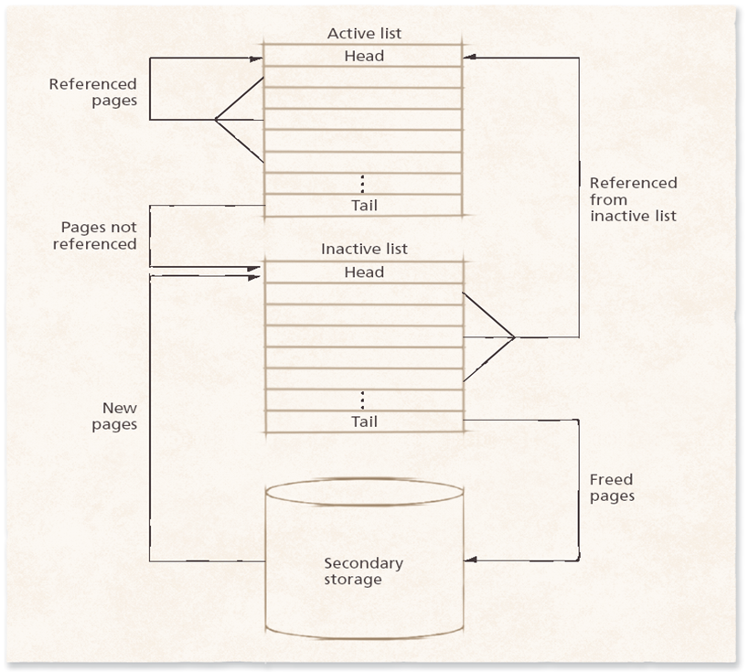
Case Study: Linux Page Replacement

